Slide 1
Linkfire Web Traffic Analysis
Analysis By: Maayan Kaidar

Slide 2
This project aims to analyze website traffic over the course of one week, focusing on events distribution and strategies to improve click-through rates (CTR).
It examines three levels of user engagement:
Pageview - Basic level of engagement, where a user views the page.
Preview - Mid-level interaction, where a user engages with content on the page.
Click - Actionable interaction, where a user follows a link to an external platform.
Pageview
Preview
Click

Slide 3
Exploratory Data Analysis
Total and average number of events over a one-week period?
What are the trending countries?
Click-Through Rate (CTR*)?
CTR distribution?
Correlation between previews and clicks?
Clicks
* CTR: The ratio of clicks to pageviews.
100
Pageviews

Slide 4
Results/Findings
Most of the traffic peaked slightly before the weekend, possibly because people tend to listen to music more during work, study, or workout sessions. Traffic dropped below average later in the week, potentially due to users spending more time with family over the weekend.
Clicks and previews were low compared to pageviews, suggesting there is potential to increase clicks by raising the preview rate, as shown later in the analysis.
The slight uptick in previews during the middle of the week may indicate users' curiosity about new music.
The USA, India, France, Saudi Arabia, and the UK are the most popular regions driving traffic.
Exploring localized content or marketing strategies tailored to these regions could help increase engagement and optimize traffic.

Slide 5
Results/Findings
The CTR distribution shows that most user links fall within the 30-50% range, which serves our customers well, but there is potential to push this higher.
The average click-through rate (CTR) is 46.76%, which is acceptable but could be significantly improved. To achieve this, we should explore methodologies to enhance how previews are presented to users. By optimizing the preview experience and making it more engaging, we can capture users' attention more effectively, leading to higher clicks and, ultimately, increased pageviews.
The correlation between clicks and previews is exceptionally strong, with a Pearson correlation coefficient of 0.96. This indicates a near-perfect relationship, meaning that as previews increase, clicks also rise significantly. This highlights the importance of optimizing and increasing preview events to drive higher engagement and clicks.

Slide 6
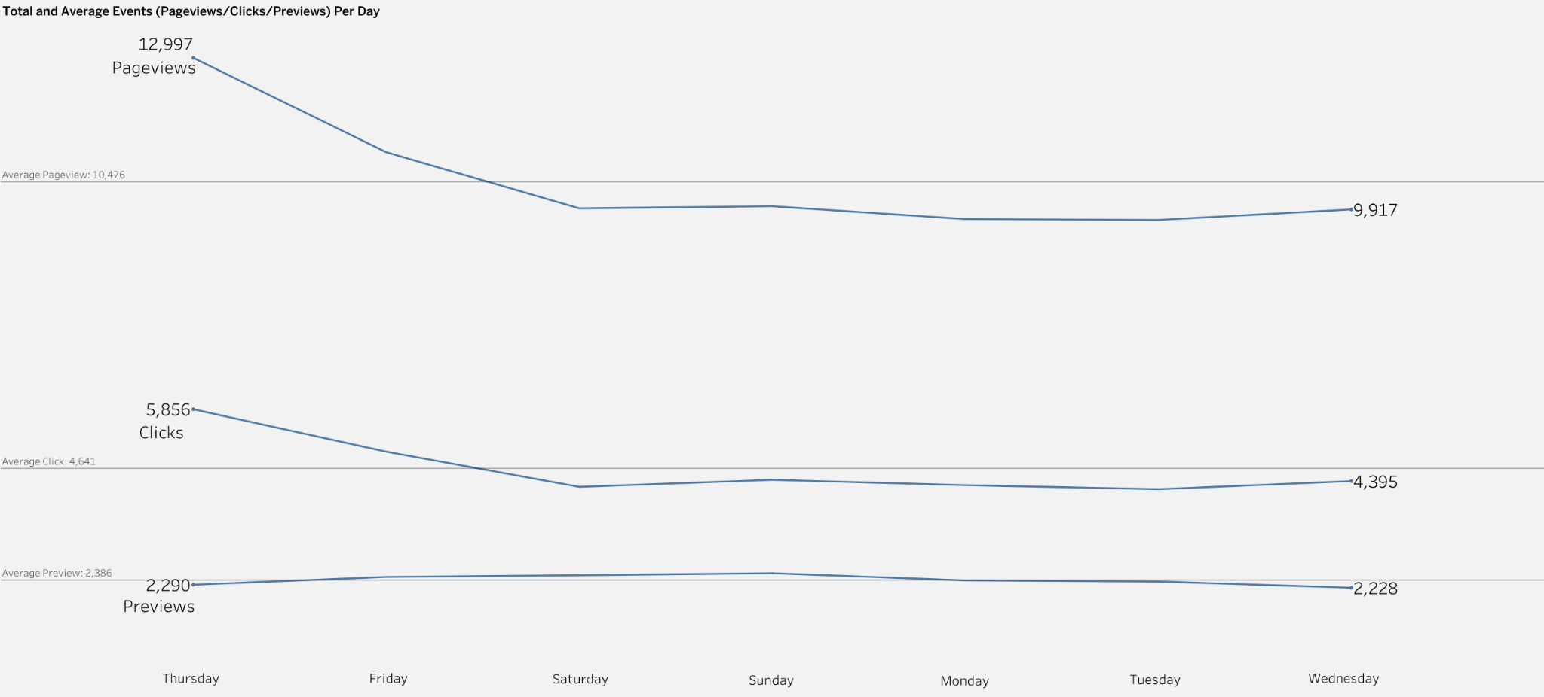

Slide 7
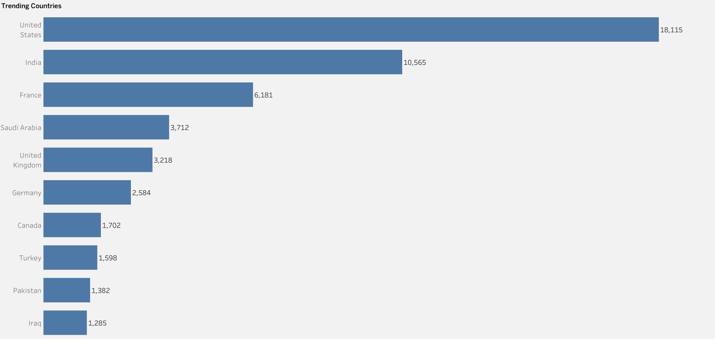

Slide 8
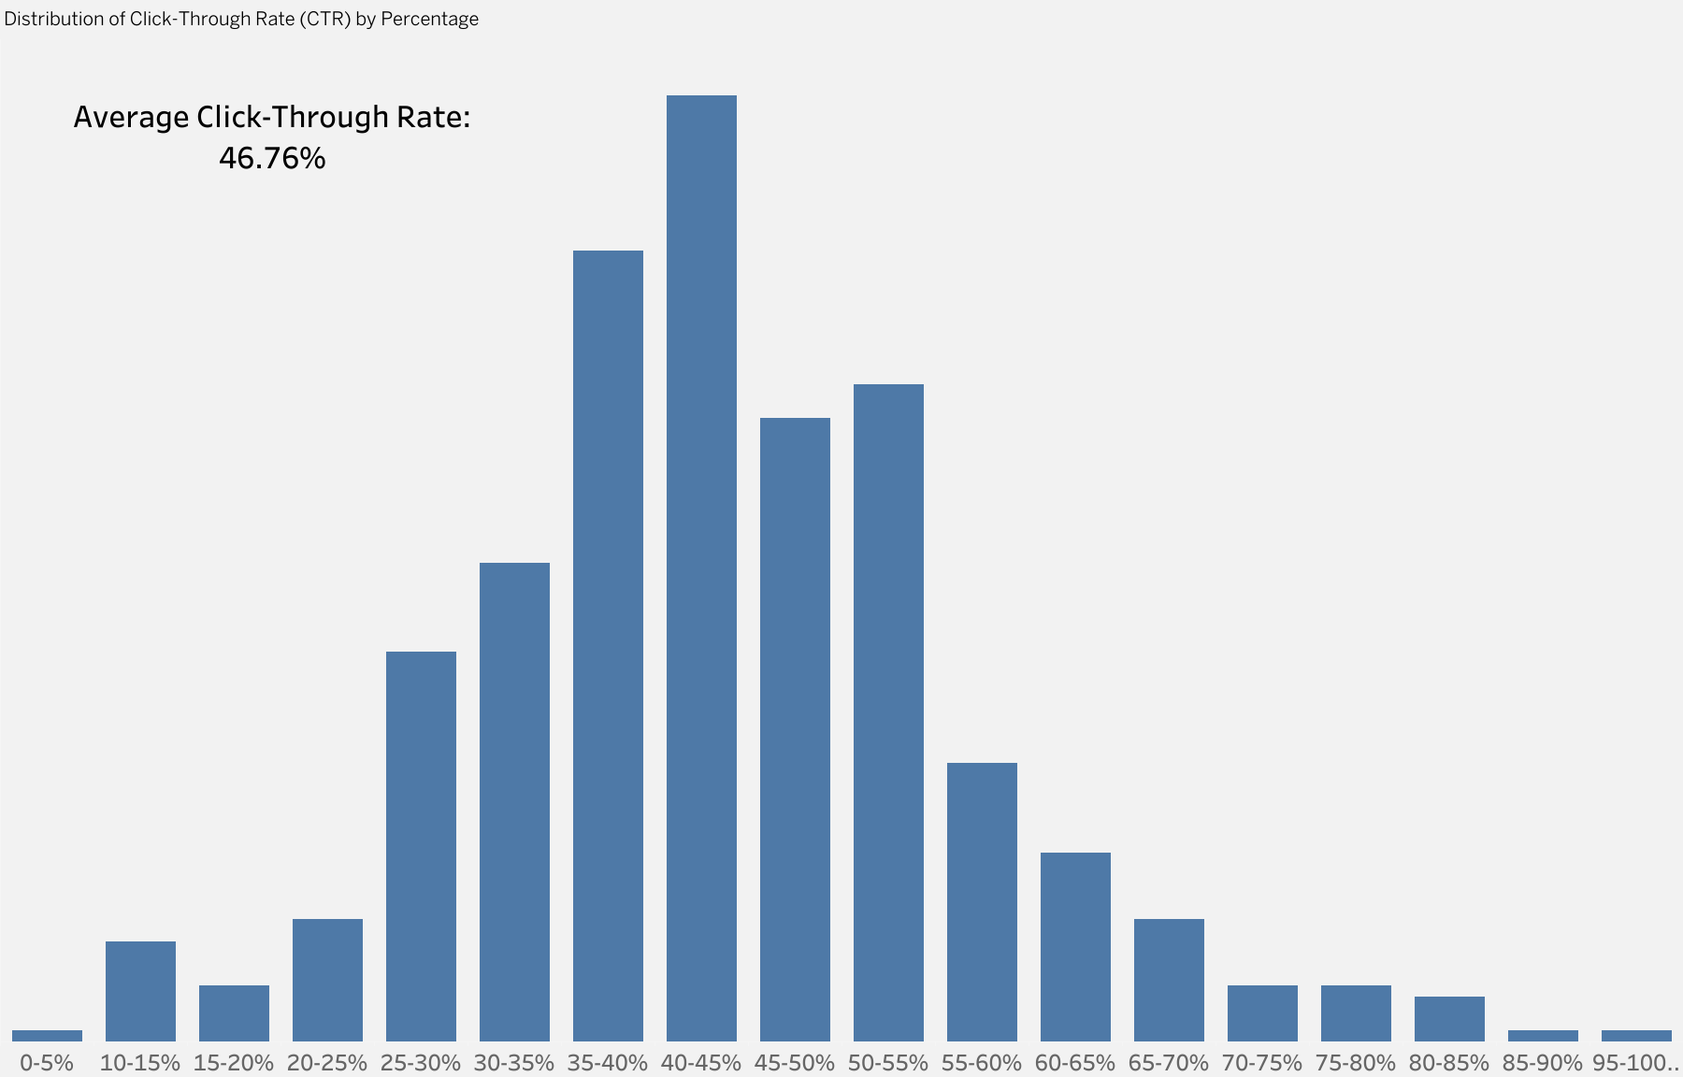
Amount of samples(links): 3822

Slide 9
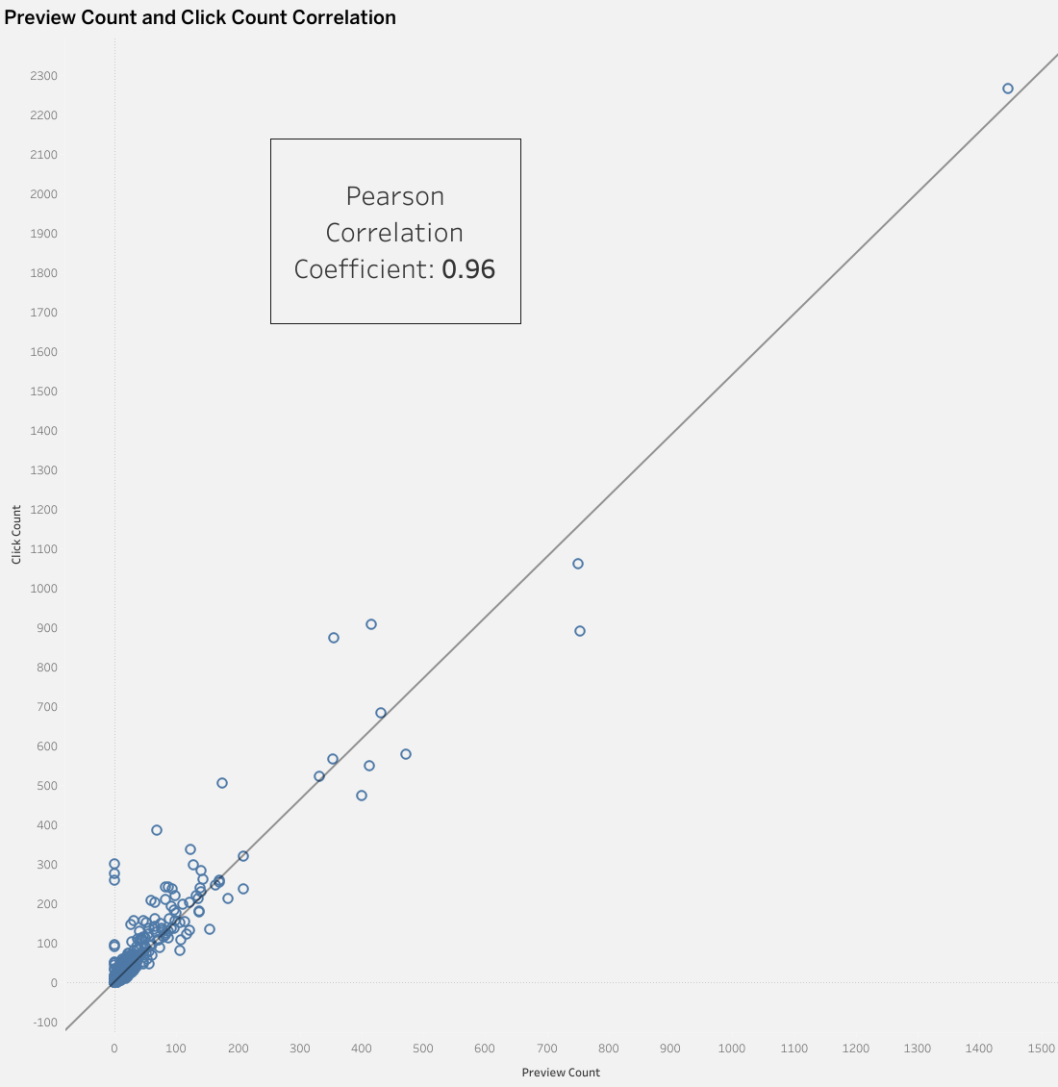
Amount of samples(links): 3822

Slide 10
Recommendations
Launch targeted campaigns or promotions slightly before the weekend to capitalize on peak traffic periods.
Develop localized content and marketing strategies for the USA, India, France, Saudi Arabia, and the UK to enhance engagement.
Improve the preview experience through engaging methodologies to increase CTR and, in turn, boost clicks and pageviews.
Focus on optimizing and increasing preview events to leverage the strong correlation with clicks and drive higher engagement.

